Slide 1

Microsoft Entra Permissions Management
Onboarding
<Name>
<Job role>

Slide 2
Agenda
Microsoft Entra Permissions Management RBAC Configuration
Azure
AWS
GCP

Slide 3
MEPM RBAC Configuration

Slide 4
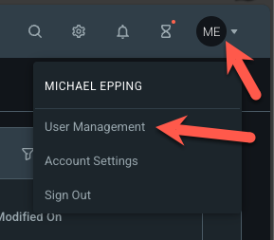
MEPM Roles
Roles → Manage from User Management menu
Recommendations
Azure AD Role: Global Administrator
Use only for initial setup of Entra Permissions Management
Azure AD Role: Permissions Management Administrator
Manage role through PIM and/or PIM Groups. Use for most “root user” tasks in MEPM rather than Global Administrator.
Custom MEPM Roles: Used to limit admins to specific Auth system types
Map to PIM-managed Azure AD Security Groups

Slide 5

Azure Onboarding
Identities
Actions
Resources
Microsoft Entra Permissions
Management (CIEM)
Over privileged identities
Irregular permission pattens
Unused permissions
& more

Slide 6
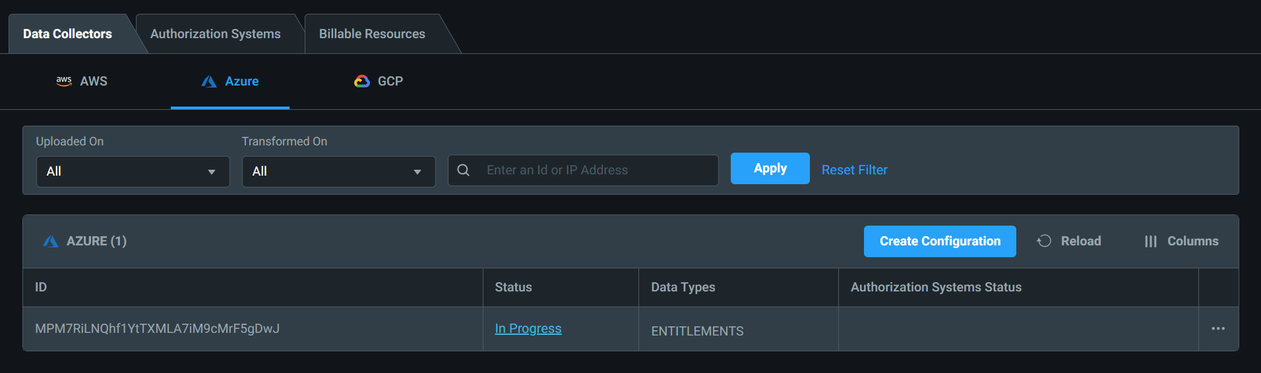
Azure Setup
Add Azure subscription details
In the EPM portal, navigate to the "Data Collectors" tab, select Azure, and click Create Configuration

Slide 7
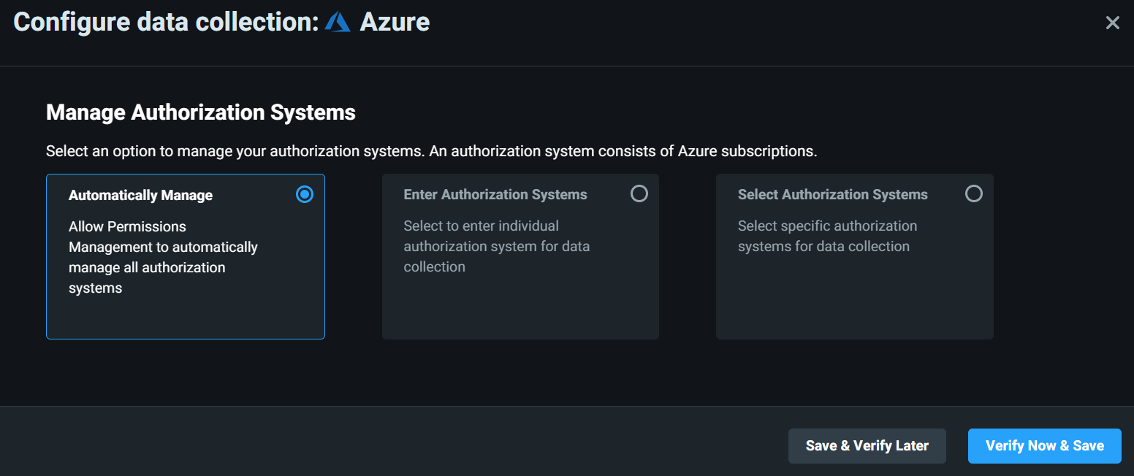
Azure Setup
2. Ensure Automatically Manage is selected. Click Verify Now & Save

Slide 8
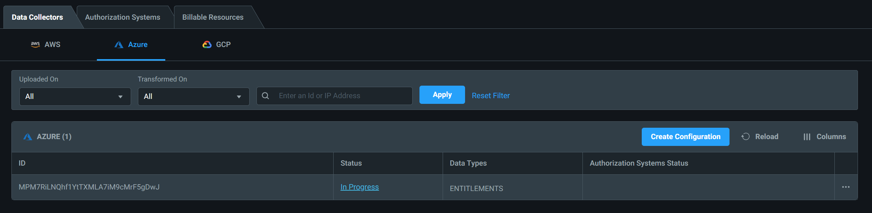
Azure Setup
3. You will now see the Azure Data Collector

Slide 9

AWS Onboarding
Identities
Actions
Resources
Microsoft Entra Permissions
Management (CIEM)
Over privileged identities
Irregular permission pattens
Unused permissions
& more

Slide 10
AWS Setup
Azure AD OpenID Connect Application (App Registration)
Can be run by any role that can create app registrations
Recommend using Azure Cloud Shell for simplicity
App name and API can be customized if desired
#use this script for Azure version >3.7
az ad app create --display-name "mciem-aws-oidc-connector" --identifier-uris "api://mciem-aws-oidc-app" --sign-in-audience AzureADMyOrg
#PowerShell Script
New-AzureADApplication -DisplayName "mciem-aws-oidc-connector" -IdentifierUris "api://mciem-aws-oidc-app"

Slide 11
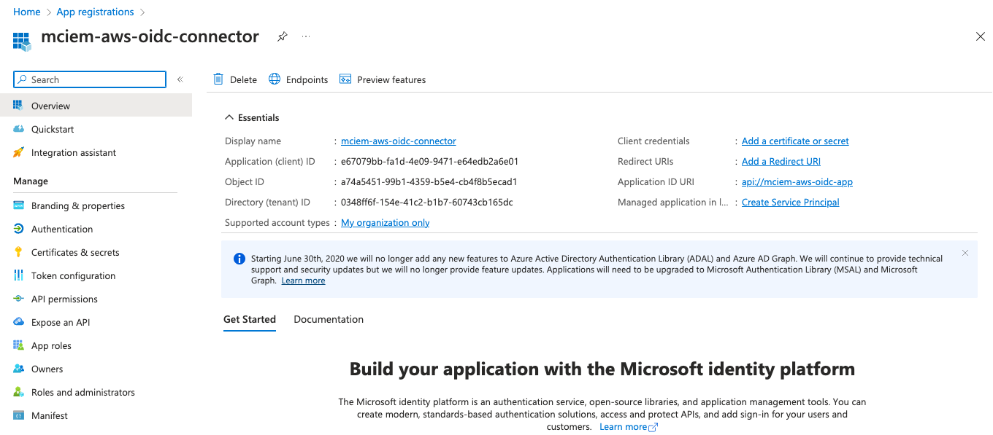
AWS Setup
Azure AD OpenID Connect Application (App Registration)
Can be run by any role that can create app registrations
Recommend using Azure Cloud Shell for simplicity
App name and API can be customized if desired

Slide 12
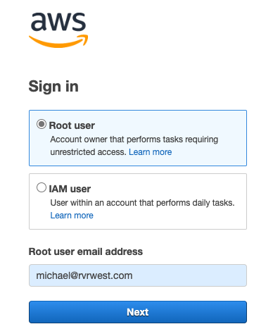
AWS Setup
AWS Account OIDC Account ID
If you aren’t sure what this is, go to https://console.aws.amazon.com and login with your AWS Root user account:

Slide 13
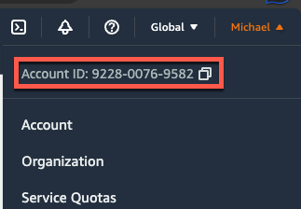
AWS Setup
AWS Account OIDC Account ID
Get the Account ID from the menu in the upper right corner of the portal:

Slide 14
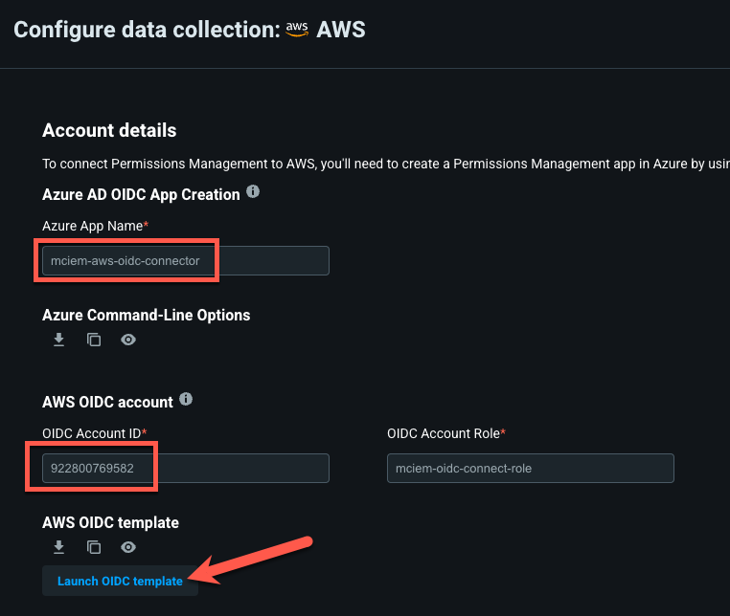
AWS Setup
Run AWS Template
Provide the Azure App Name and OIDC Account ID identified in previous steps
Click the Launch OIDC template button

Slide 15
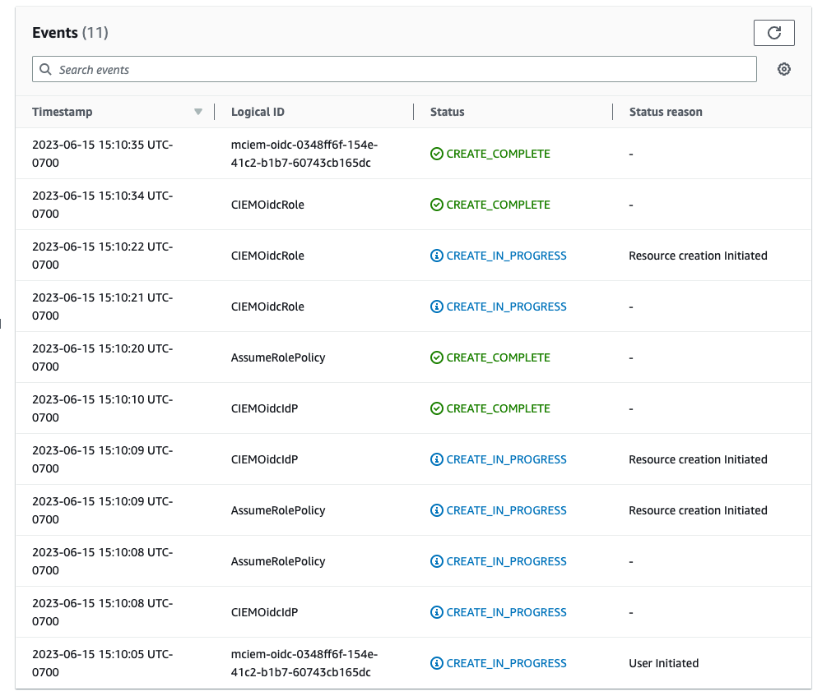
AWS Setup
Run AWS Template
An AWS CloudFormation template will open with the parameters already filled in
This is an infrastructure as code template, similar to Azure ARM templates
This particular template creates an OIDC provider on the AWS side

Slide 16
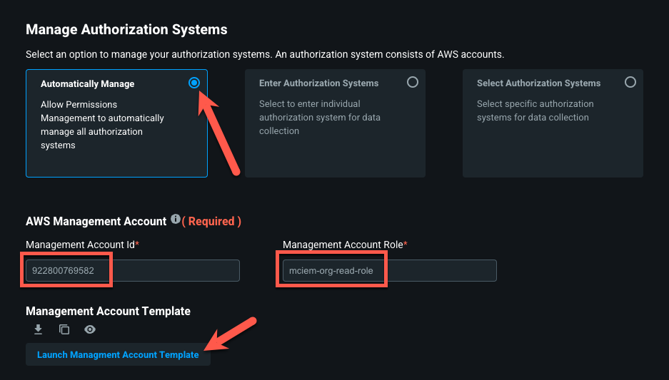
AWS Setup
Manage Authorization Systems
We recommend choose Automatically manage for the POC
Must provide the Management Account ID, which may be the same ID as the last step
Launch Management Account Template and then click Create Stack in AWS

Slide 17
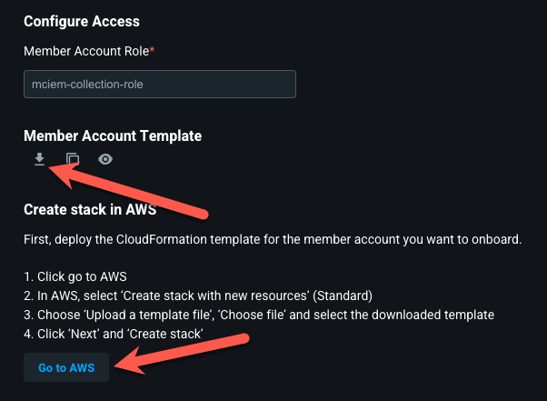
AWS Setup
Manage Authorization Systems – Member Account Role
A 3rd CloudFormation template needs to be run to configure the member account
Click Go to AWS

Slide 18
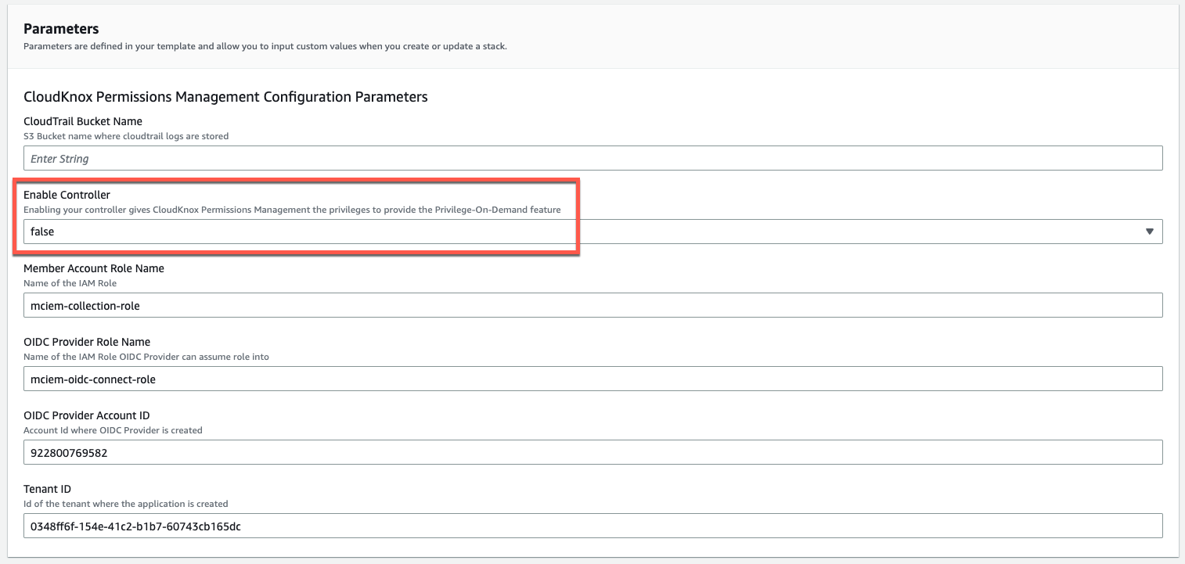
AWS Setup
Manage Authorization Systems – Member Account Role
Review the template – if you’d like to enable read/write features in Entra Permissions Management then change the Enable Controller setting to true:

Slide 19
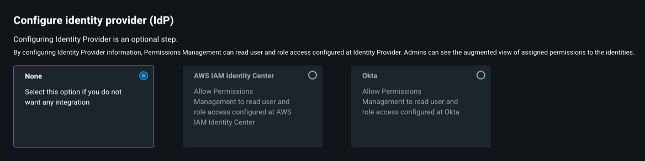
AWS Setup
If you use AWS Identity Provider, then follow additional steps to integrate

Slide 20
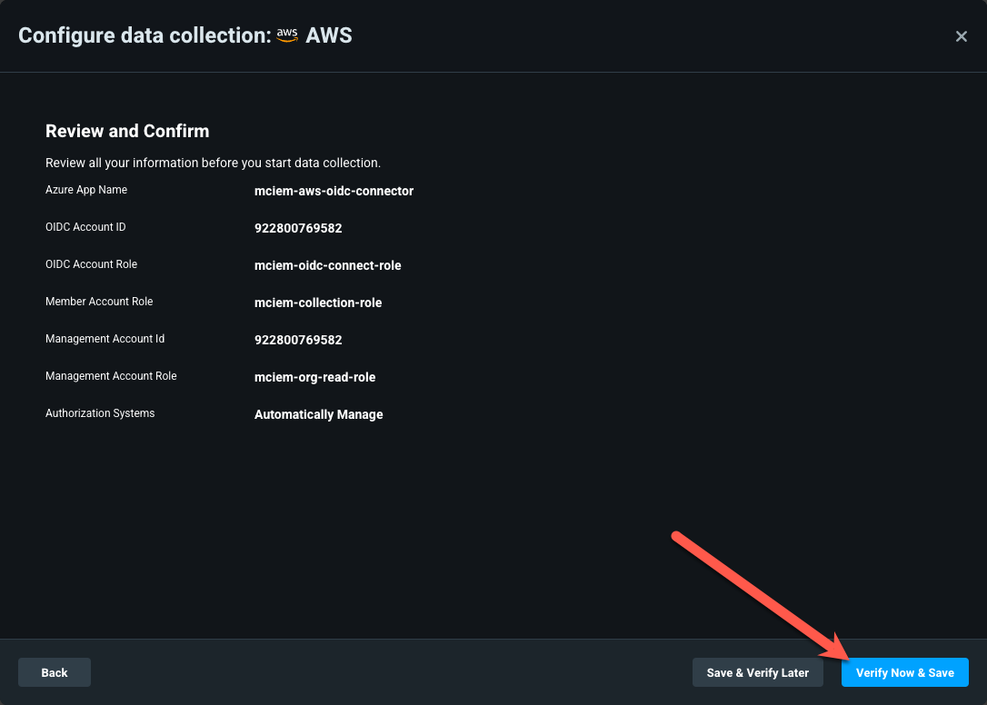
AWS Setup
Finally, review your configuration and click Verify Now & Save:

Slide 21
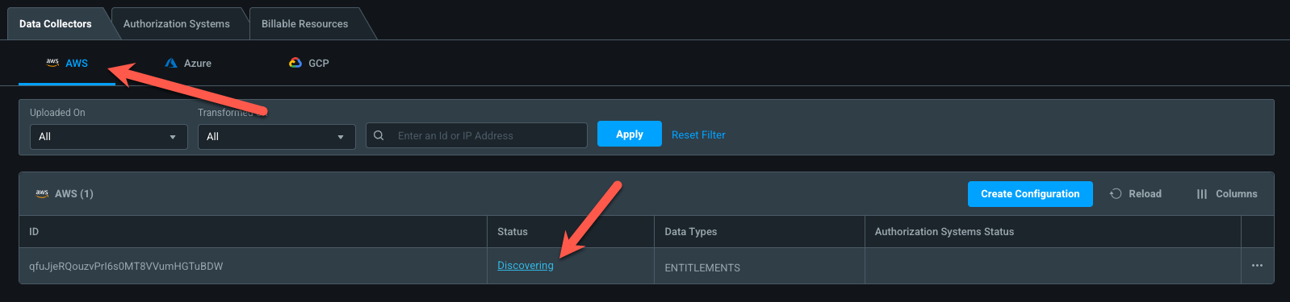
AWS Setup
You should now see an AWS Data Collector with a Discovering Status. Discovery may take some time.

Slide 22

GCP Onboarding
Identities
Actions
Resources
Microsoft Entra Permissions
Management (CIEM)
Over privileged identities
Irregular permission pattens
Unused permissions
…

Slide 23
GCP Setup
Azure AD OpenID Connect Application (App Registration)
Can be run by any role that can create app registrations
Recommend using Azure Cloud Shell for simplicity
App name and API can be customized if desired
#use this script for Azure version >3.7 az ad app create --display-name "mciem-gcp-oidc-app" --identifier-uris "api://mciem-gcp-oidc-app" --sign-in-audience AzureADMyOrg
#PowerShell Script New-AzureADApplication -DisplayName "mciem-gcp-oidc-app" -IdentifierUris "api://mciem-gcp-oidc-app"

Slide 24
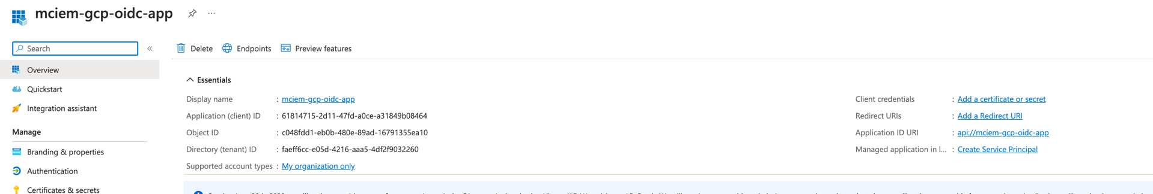
GCP Setup
Azure AD OpenID Connect Application (App Registration)
Can be run by any role that can create app registrations
Recommend using Azure Cloud Shell for simplicity
App name and API can be customized if desired

Slide 25
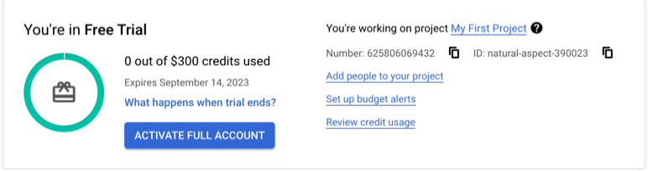
GCP Setup
2. Setup a GCP OIDC Project
You’ll need to go to the GCP console and get the project ID and project number. This is on the home page of the project

Slide 26
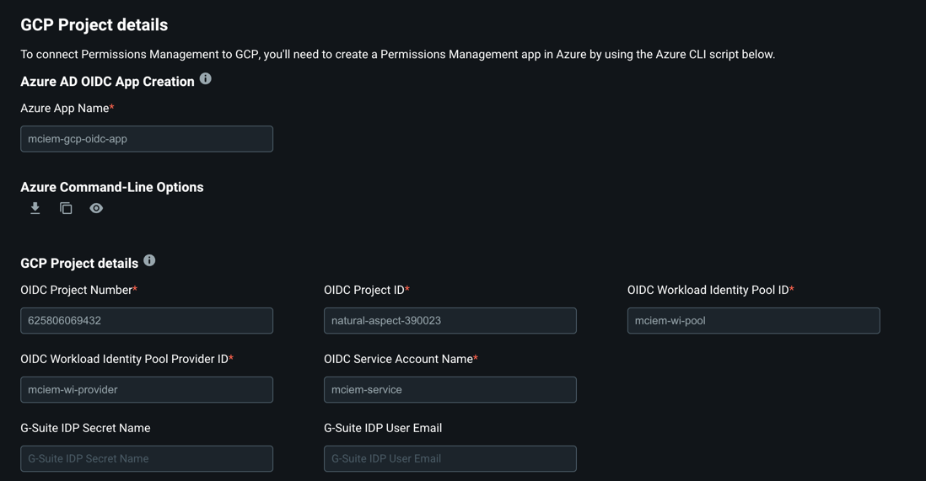
GCP Setup
2. Setup a GCP OIDC Project
You can update the Workload Identity PoolID, ProviderID or ServiceAccount name if you wish or accept the defaults. You will now need to go to the GCP console

Slide 27
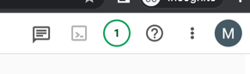
GCP Setup
3. Run Setup script in Google Cloud Shell. It’s in the upper right corner that looks like a shell prompt.
A console will open in the lower pane similar to the Azure Cloud Shell
Copy and paste the setup script. Authorize permissions to your logged in creds if needed

Slide 28
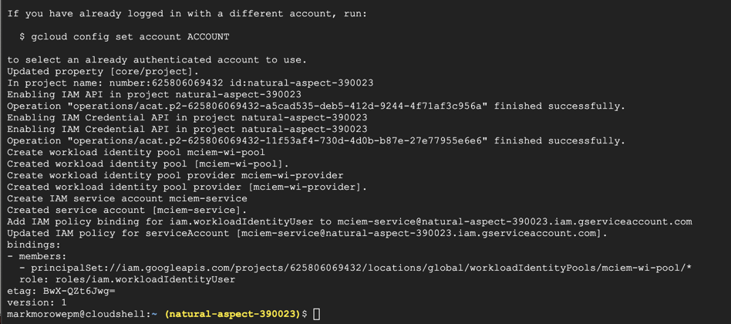
GCP Setup
4. Confirm setup is complete in the output. Click next in EPM portal

Slide 29
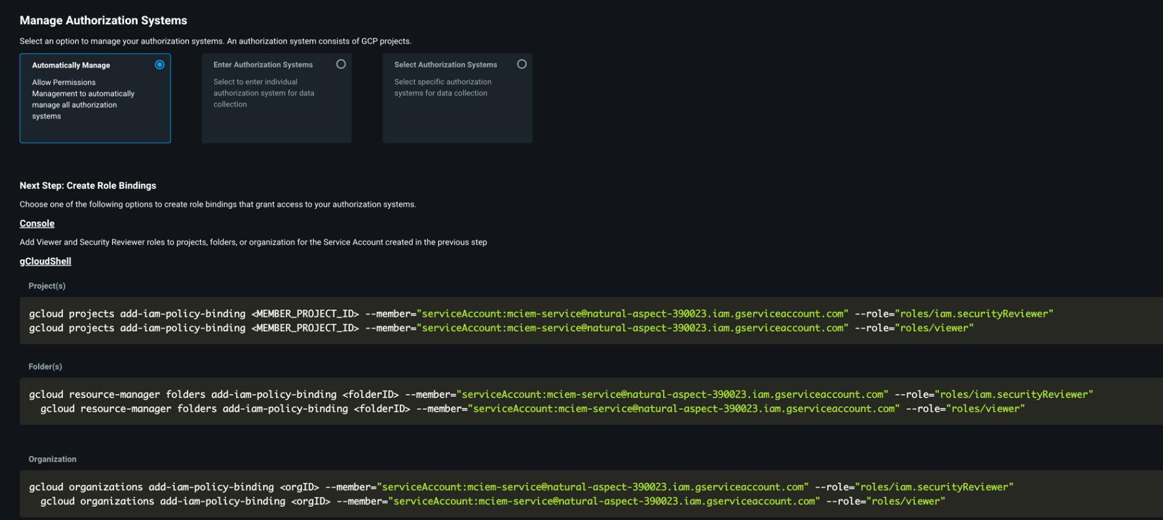
GCP Setup
5. Manage Authorization Systems
We recommend choose Automatically manage for the POC, click Next.

Slide 30
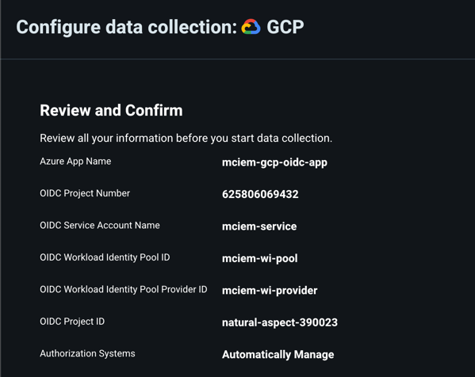
GCP Setup
6. Review and Confirm
You’ll see the setting screen. Click Verify Now & Save

Slide 31
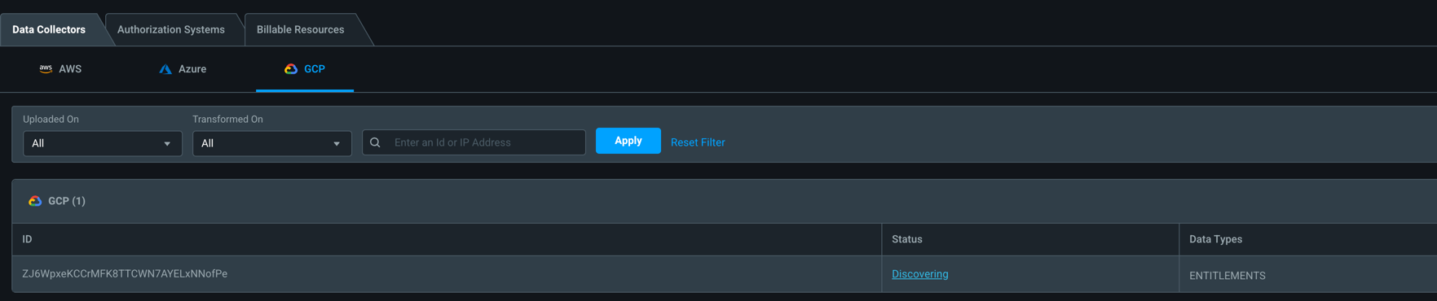
GCP Setup
You should now see an GCP Data Collector with a Discovering Status. Discovery may take some time.

Slide 32

Next Steps

Slide 33
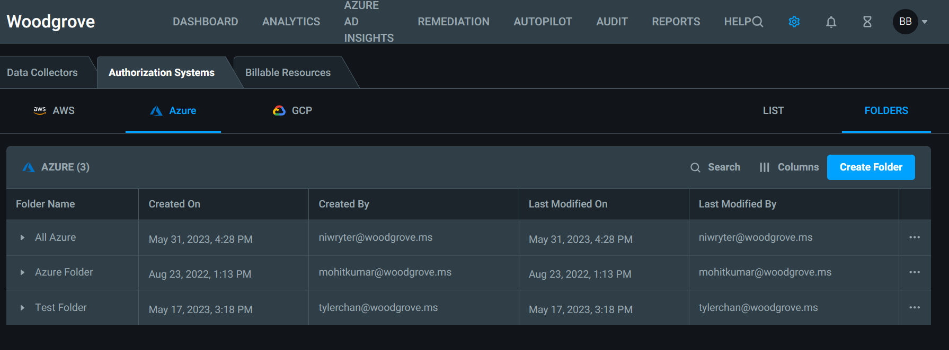
Recommendation: Create Folders
Folders ease administrative burden in the Entra Permissions Management console by organizing accounts and subscriptions
To create a folder, go to Settings (gear) > Folders > Create Folder

Slide 34
Where do we go from here?
Brilliant at the Basics
About the Performance Creep Index and Remediation
Automation and Alerting
Go-Do's

Slide 35
Resources
Onboard an Amazon Web Services (AWS) account
Onboard a Microsoft Azure subscription
Onboard a Google Cloud Platform (GCP) project
Configure AWS IAM Identity Center as an identity provider
Enable or disable the controller in Permissions Management after onboarding is complete
Add an account /subscription/ project to Permissions Management after onboarding is complete

Slide 36

Thank you!

